Slide 1
ECHOCARDIOGRAPHY …From a Sonographer’s Perspective THE NOTEBOOK 8 Chapter IVa: Transthoracic Echocardiogram
Susan King DeWitt, BS, RDCS, RCS

Slide 2
COPYRIGHT INFRINGEMENT IS A SERIOUS CRIME.
Please respect my U.S. Copyright & hard work—do not copy/distribute/edit.
Copyright © 1996, 2002, 2009, 2010, 2011, 2018, 2022. All rights reserved. Library of Congress Catalog Card Numbers: TX0006951179 and TX0008635753.
No part of this publication may be published, shared, edited, voiced over, reproduced, stored in a retrieval system, or transmitted, in any form or by any means, electronic, mechanical, photocopying, recording, or otherwise.
The information in this material is designed to provide education in the field of echocardiography and related topics. It was written, edited, and published by Susan King DeWitt, Author, LLC—a registered cardiac sonographer, not a physician, professional editor, or publishing company. This material does not guarantee a passing grade on the registry exam(s); however, it does discuss most of the test material. References provided do not constitute endorsement of any websites or other sources. Readers should be aware the information and websites listed may change.

Slide 3
ECHO…THE NOTEBOOK 8 & THE WORKBOOK 8
are currently approved by the
Society of Diagnostic Medical Sonography (SDMS)
as a self-instructional activity for
31 CME CREDITS
Please refer to www.echonotebook.com for more details!

Slide 4
IVa. TRANSTHORACIC ECHO (TTE)
OBJECTIVES
Upon completion of this section, the reader will be able to:
Discuss the TTE order, patient verification, EKG placement, patient positioning, and scanning options.
Recognize when a limited TTE is advised and some common indications.
Define different methods of calculating the LVEF.
Stay up-to-date and integrate the latest TTE guidelines, required dimensions, and routine calculations.
Identify and interpret normal cardiac anatomy.
Suggest what needs to be ruled out during TTE.

Slide 5
NOTES: TTE

Slide 6
NOTES: TTE
TTE PREP verify order, indication, diagnosis, location & urgency check medical records for previous echo gather equipment intro & reason for visit verify & enter patient data gown EKG | PATIENT POSITION flat bed with pillow position patient according to window
POP QUIZ!
What is the recommended patient position for the left vs right parasternal window?

Slide 7
NOTES: TTE
SCANNING…LEFT HAND vs RIGHT HAND proficient with both to prevent overuse adjust bed height left vs right hand scanning alternative scanning method | LIMITED TTE According to the IAC, a limited TTE should be performed when the patient recently had a complete TTE & there is no clinical reason to suspect changes other than the specific area of interest (or a single clinical question).
CONSIDER THE FOLLOWING lab policy & procedure, be flexible & personal style abnormal findings utilize & optimize settings When to call for back up?!?
POP QUIZ!
What are some common
indications for a limited TTE?

Slide 8
PARASTERNAL
LAX & SAX

Slide 9
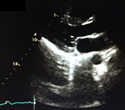
PARASTERNAL WINDOW
VIEW | PROTOCOL | IMAGES
LAX LV | Increase depth entire cardiac structure & surroundings 2) Decrease depth chamber size wall thickness global function valvular function
POP QUIZ!
Label the wall
segments #1 - 5.

Slide 10
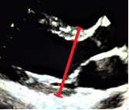
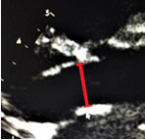
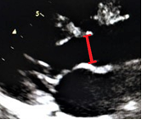
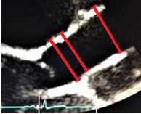
POP QUIZ!
What phase of the cardiac cycle are the dimensions acquired?
VIEW | PROTOCOL | IMAGES
LAX LV & LAX AO | 3) 2D linear dimensions RV wall RVOTprox IVS LVIDd PWT LVIDs LA LVOT AOV annulus sinuses of Valsalva sinotubular junction proximal AAO

Slide 11
LVEF
FS%
BIPLANE METHOD OF DISKS
STRAIN IMAGING
3D IMAGING
EYEBALL IT
TEICHOLTZ METHOD
POP QUIZ!
What does LVEF measure &
what methods are discouraged?

Slide 12
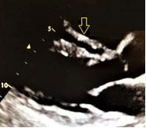
VIEW | PROTOCOL | IMAGES
LAX LV | 4) Anterior wall of RV thin squeezes concentrically end-diastolic RV wall thickness (1 - 5 mm) 5) RV most anterior chamber smaller & more trabeculated than LV complex crescent shape—tricky to measure moderator band end-diastolic RVOTprox diameter (20 - 30 mm)
POP QUIZ!
What does the
arrow indicate?

Slide 13
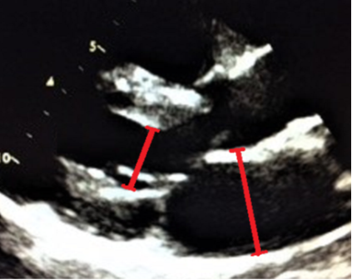
According to the ASE Guidelines,
acquire LV dimensions perpendicular to the structures,
in a straight line,
at or immediately below the tips of the MV leaflets,
with calipers placed at myocardial wall/cavity interface & wall/pericardium interface.

Slide 14
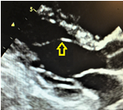
VIEW | PROTOCOL | IMAGES
LAX LV | 6) IVS & LVPW 1:1 ratio thicker than RV walls squeeze concentrically sigmoid-shaped septum end-diastolic IVS & PWT dimensions (female 6 - 9 mm, male 6 - 10 mm) 7) LV largest chamber posterior & lateral to RV ellipsoid shape larger, more conical & less trabeculated than RV false tendon LVIDd (female 38 - 52 mm, male 42 - 58 mm) LVIDs (female 22 - 35 mm, male 25 - 40 mm)
POP QUIZ!
What do the arrows indicate?

Slide 15
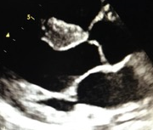
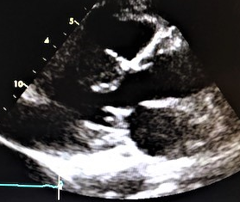
LVH SEVERITY SCALE
 | NORMAL (mm) | MILD LVH (mm) | MOD LVH (mm) | SEVERE LVH (mm)
MALE | 6 - 10 | 11 - 13 | 14 - 16 | ≥ 17
FEMALE | 6 - 9 | 10 - 12 | 13 - 15 | ≥ 16
POP QUIZ!
If the IVS & PWT measure 15 mm, what is the degree of LVH?

Slide 16
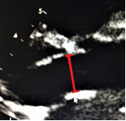
VIEW | PROTOCOL | IMAGES
LAX LV | 8) LVOT unobstructed laminar flow zoom & adjust gains mid-systolic LVOT diameter (18 - 22 mm)
POP QUIZ!
Where exactly is the
LVOT diameter acquired?

Slide 17
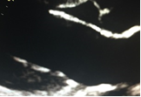
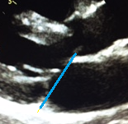
VIEW | PROTOCOL | IMAGES
LAX LV | 9) AMVL & PMVL thin & pliable unrestricted opening continuous with posterior wall of AO AMVL more mobile no MVP/MAC
POP QUIZ!
What does the blue line indicate?

Slide 18
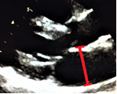
VIEW | PROTOCOL | IMAGES
LAX LV | 10) LA most posterior chamber reservoir that receives PV4 return passageway to LV contractile pump (atrial systole/kick) size is gender dependent & indexed to BSA smaller than LV end-systolic anteroposterior LA linear dimension (female 27 - 38 mm, male 30 - 40 mm) LA linear dimension vs LAVi
POP QUIZ!
What percentage of LV filling is provided by the atrial kick?

Slide 19
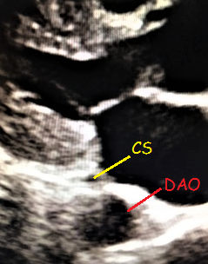
VIEW | PROTOCOL | IMAGES
LAX LV | 11) SAX of CS 4 - 10 mm within myocardium posterior to LA-LV junction narrows during atrial contraction 12) SAX of DAO separate structure posterior to LA
POP QUIZ!
What does the arrow indicate?

Slide 20
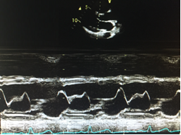
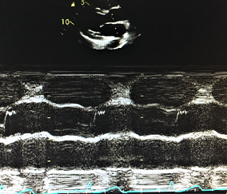
POP QUIZ!
What does the arrow indicate?
VIEW | PROTOCOL | IMAGES
LAX LV | 13) M-mode sweep continuous strip continuity from posterior AO root wall → AMVL wall motion timing of cardiac cycle

Slide 21
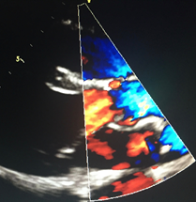
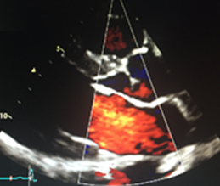
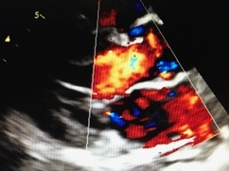
VIEW | PROTOCOL | IMAGES
LAX LV | 14) Doppler sweep AOV & LVOT LVOT & MV MR IVS When is spectral Doppler of the IVS indicated?
POP QUIZ!
How is this →
image different
& is it useful?

Slide 22
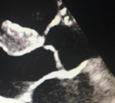
VIEW | PROTOCOL | IMAGES
LAX AO | 15) AOV RCC & NCC equal, thin & pliable unrestricted opening cusps disappear into AO walls during systole

Slide 23
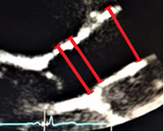
VIEW | PROTOCOL | IMAGES
LAX AO | 16) Max AO dimensions perpendicular to LAX AO (A) AOV annulus diameter I - I female 23 ± 2 mm, male 26 ± 3 mm sinuses of Valsalva diameter L - L female 30 ± 3 mm, male 34 ± 3 mm sinotubular junction diameter L - L female 26 ± 3 mm, male 29 ± 3 mm proximal AAO diameter L - L female 27 ± 4 mm, male 30 ± 4 mm
POP QUIZ!
Label A & A* - D, include timing of the dimensions.

Slide 24
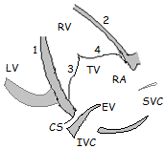
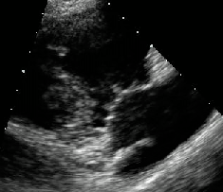
VIEW | PROTOCOL | IMAGES
LAX RVIT | 17) Anterior & inferior RV walls thin & squeeze concentrically 18) RV most anterior chamber & trabeculated complex crescent shape 19) Anterior & posterior TV leaflets thin & pliable leaflets unrestricted opening 20) RA smaller than RV reservoir for systemic venous return assists in RV filling eustachian valve Chiari network
POP QUIZ!
Label the anatomy #1 - 4.
POP QUIZ!
Where are the RA
embryonic variants located?

Slide 25
VIEW | PROTOCOL | IMAGES
LAX RVIT | 21) CFD RA, TV & RV TR up to 93% have trace to mild TR 22) TV inflow PWD gate at tips of TV leaflets 23) CWD of TV (0.3 - 0.7 m/s) TV peak TRV calculate RVSP
POP QUIZ!
What does
the blue jet indicate?

Slide 26
NOTES: TR & RVSP CALCULATION
In the absence of RVOTO, peak TRV & mean RAP are used to estimate RVSP & assess PH. RVSP = SPAP compare views utilize CFD to locate TR jet, optimize Doppler angle & place CWD focus within jet ? filling in adequately… acquire peak TRV calculate RV-RA PG (4V² where V = peak TRV) if a central line is present, CVP = RAP, or estimate the mean RAP (ASE recommends 3/8/15 method) SUB IVC IVC diameter (1.2 - 2.1 cm) at rest, normal respiration, perpendicular angle, ~ 1 - 2 cm distal to RA exception: normal young athletes IVC inspiratory collapse/sniff test estimate mean RAP calculate RVSP = 4(peak TRV)² + mean RAP assess PH
POP QUIZ!
What is RVSP dependent upon?
IVC PARAMETERS | ESTIMATE MEAN RAP (mmHg)
< 2.1 cm & > 50% collapse | 3 (normal)
> 2.1 cm < 50% collapse | 15 (increased)
IVC does not fit the model | 8 (intermediate)

Slide 27
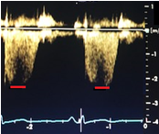
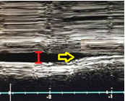
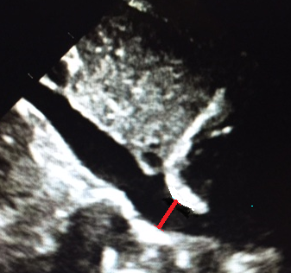
PH SEVERITY SCALE | RVSP (mmHg)
NORMAL RVSP (or SPAP) | 18 - 25
MILD PH | 30 - 40
MOD PH | 40 - 70
SEVERE PH | > 70
EXAMPLE: If peak TRV = 2.3 m/s, IVC diameter = 1.6 cm & collapses > 50% upon inspiration, then… RVSP = 4 (peak TRV)² + mean RAP = 4 (2.3)² + 3 = 21 + 3 = 24 mmHg
POP QUIZ!
Calculate the RVSP & classify the degree of PH
if peak TRV = 3 m/s, IVC diameter = 2.4 cm & collapses < 50% upon sniff test.

Slide 28
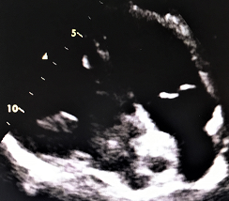
VIEW | PROTOCOL | IMAGES
LAX RVOT | 24) Anterior wall of RVOT thin 25) Infundibulum smooth-walled funnel shaped portion of RVOT entrance of pulmonary trunk 26) Right & left PV cusps thin, delicate & pliable unrestricted opening 27) Main PA PA diameter < AO diameter bifurcation → RPA & LPA measure midway between PV & PA bifurcation (< 30 mm or < AO diameter)
POP QUIZ!
Label the anatomy #1 - 2.
POP QUIZ!
What are the calipers measuring?

Slide 29
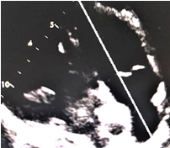
VIEW | PROTOCOL | IMAGES
LAX RVOT | 28) PV M-mode right posterior PV cusp resembles AOV M-mode PV a-wave dip (2.7 mm)
POP QUIZ!
What structure is the right
posterior PV cusp always adjacent to?
POP QUIZ!
What does the flying W indicate?

Slide 30
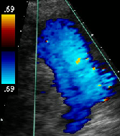
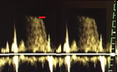
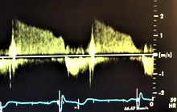
VIEW | PROTOCOL | IMAGES
LAX RVOT | 29) CFD RVOT, PV, PA & bifurcation trace to mild PR—within normal limits 30) PWD/CWD of PV (0.6 - 0.9 m/s) PV PR EDPR velocity (V) EDPR gradient (0 - 5 mmHg) via PG = 4V²
EXAMPLE: If the EDPR velocity = 0.7 m/s, then… EDPR gradient = 4V² = 4 (0.7)² = 1.96 = 2 mmHg (normal)
POP QUIZ!
What does the
red jet indicate?

Slide 31
VIEW | IMAGES
SAX BASE | 31) RV most anterior chamber unique crescent shape diameter → predictor of mortality in HF patients end-diastolic RVOTprox diameter (21 - 35 mm) end-diastolic RVOTdistal diameter (17 - 27 mm)
POP QUIZ!
Label the dimensions.

Slide 32
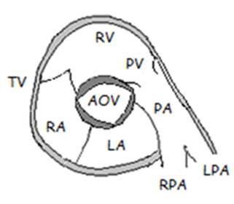
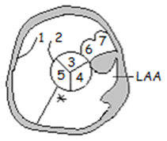
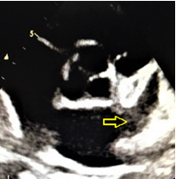
POP QUIZ!
Label the
anatomy #1 - 7.

Slide 33
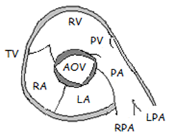
VIEW | PROTOCOL | IMAGES
SAX BASE | 32) Anterior & medial TV leaflets thin, pliable & unrestricted opening 33) RCC, LCC & NCC of AOV thin, delicate, pliable & unrestricted opening disappear into AO walls during systole trileaflet → round, upside-down Mercedes™ star 34) Right posterior & anterior PV cusps thin, delicate, pliable & unrestricted opening RA reservoir for systemic venous return assists RV filling eustachian valve & Chiari network
POP QUIZ!
Name the AOV cusp
that is always
adjacent to the IAS?

Slide 34
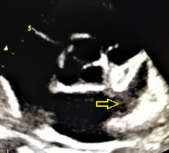
VIEW | PROTOCOL | IMAGES
SAX BASE | 36) IAS bows slightly → RA (LAP > RAP) moves as LAP & RAP change 37) LA most posterior chamber reservoir that receives PV4 return passageway to LV contractile pump LAA remnant of embryonic LA long, tubular, hooked appendage within pericardium, alongside LV directly affected by LVFX decompression chamber prone to thrombus (Afib, MV disease)
POP QUIZ!
What does the arrow indicate?

Slide 35
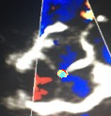
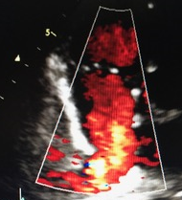
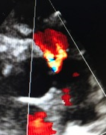
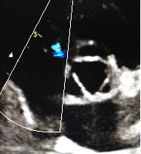
VIEW | PROTOCOL | IMAGES
SAX BASE | 38) Doppler sweep RVIT MILD TR TV & PEAK TRV IAS AOV central AR RVOT PR PV & PR
POP QUIZ!
Is CWD of the
AOV indicated
from the SAX?

Slide 36
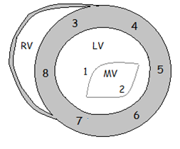
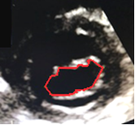
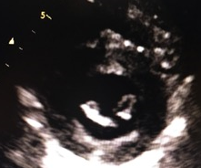
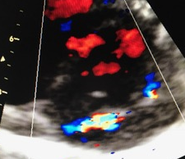
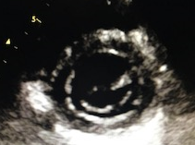
VIEW | PROTOCOL | IMAGES
SAX BASAL/MV | 39) AMVL & PMVL thin & pliable unrestricted opening fish mouth AMVL continuous with posterior wall of AO no MAC MV planimetry 40) CFD MV IVS
POP QUIZ!
Label the anatomy # 1 - 8.
POP QUIZ!
What is the turbulent systolic flow?

Slide 37
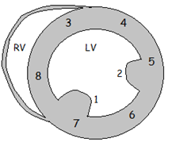
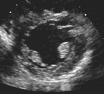
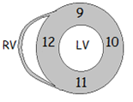
VIEW | PROTOCOL | IMAGES
SAX PM/MID & SAX APEX | 41) LV round walls thicken & squeeze concentrically visualize all LV walls simultaneously RV is smaller 42) CFD IVS
POP QUIZ!
What is SALI?
POP QUIZ!
Label the anatomy #1 - 12.

Slide 38
APICAL
4C, 5C, 2C & 3C

Slide 39
APICAL WINDOW
VIEW | PROTOCOL | IMAGES
4C | 43) Increase depth entire cardiac structure & surroundings 44) Decrease depth chamber size wall thickness global function valvular function

Slide 40
POP QUIZ!
Label the anatomy #1 - 11.

Slide 41
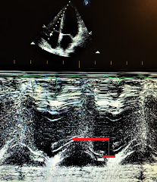
POP QUIZ!
How is TAPSE acquired?
VIEW | PROTOCOL | IMAGES
4C | 45) Lateral & septal RV walls thin squeeze concentrically TAPSE—global RV systolic fxn (< 17 mm indicates decreased RVFX)

Slide 42

VIEW | PROTOCOL | IMAGES
4C | 46) RV no more than 2/3 size of LV more trabeculations & they are coarser than the LV moderator band report RVD if RV size > LV size report ICD/pacemaker wire if indicated, acquire linear dimensions emphasis on right heart end-diastolic RV basal diameter (25 - 41 mm) end-diastolic RV mid-diameter (19 - 35 mm) longitudinal dimension (59 - 83 mm)—no longer ASE Guidelines 47) Anterior & medial TV leaflets thin, pliable & unrestricted opening
POP QUIZ!
What do the red, blue
& yellow lines represent?

Slide 43

VIEW | PROTOCOL
4C | 48) RA smallest chamber, reservoir for systemic venous return & assists RV filling eustachian valve & Chiari network report ICD/pacemaker wire RAV (female 21 ± 6 ml/m², male 25 ± 7 ml/m²) single-plane area-length or disk summation technique RAV more accurate than linear dimensions gender dependent RAV appears < LAV 4C, emphasis on right heart, zoom, end systole RAA via planimetry (< 18 cm²) RA major dimension (< 5.3 cm) RA linear dimensions & RAA RA major dimension (< 5.3 cm) RA minor dimension (< 4.4 cm) RAA via planimetry (< 18 cm²)
POP QUIZ!
What do the red,
blue & yellow
lines represent?

Slide 44

POP QUIZ!
What do the arrows indicate?

Slide 45
VIEW | PROTOCOL | IMAGES
4C | 49) Lateral & septal LV walls thicker than RV walls squeeze concentrically 50) LV largest chamber longer, more conical & less trabeculated than RV forms the apex with the RV LVV & LVEF
According to the 2019 ASE Guidelines, acquire the LV dimensions with the calipers placed at the interface between compacted & noncompacted myocardium for all 2D & 3D measurements. If this interface cannot be determined, use the blood-tissue interface.

Slide 46
PROTOCOL | IMAGES
BIPLANE METHOD OF DISKS if 3D volumetric analysis not available, biplane method of disks is next best & most common method reliable estimate of LVEDV & LVESV zoom, avoid apical foreshortening if indicated, use contrast agent 4C & 2C, acquire EDV 4C & 2C, acquire ESV 4C & 2C, acquire LV length
4C
2C
POP QUIZ!
What is the
LVEF formula?
BIPLANE METHOD OF DISKS | FEMALE | MALE
EDV indexed to BSA (mL/m²) | < 61 | < 74
ESV indexed to BSA (mL/m²) | < 24 | < 31
LVEF % (20+ years) | 53 - 73%

Slide 47



VIEW | PROTOCOL | IMAGES
4C | 51) AMVL & PMVL thin, pliable & unrestricted opening AMVL more mobile no MVP/MAC 52) LA most posterior chamber reservoir that receives PV4 return passageway to LV contractile pump LA appears slightly larger than RA smaller than ventricles LAVi = LAV/BSA (details to follow) Rule out LA abnormalities LAE clot/mass IAS bowing/aneurysm
POP QUIZ!
Identify the red line,
yellow line & arrows.

Slide 48



VIEW | PROTOCOL | IMAGES
4C | 54) Doppler sweep RA, TV & RV TR TV & peak TRV PWD of TV inflow (not shown) IAS & IVS LA, MV & LV MR
POP QUIZ!
Locate the
TR & MR.

Slide 49




VIEW | PROTOCOL | IMAGES
4C | 54) Doppler sweep (continued) MV & MR MV inflow TDI of MV annulus PV4
POP QUIZ!
What is the difference between
CWD of the MV
& PWD of the MV inflow?

Slide 50



VIEW | PROTOCOL | IMAGES
5C | 55) RCC & NCC of AOV thin, delicate & pliable unrestricted opening disappear into AO walls 56) LVOT unobstructed laminar flow 57) MV apparatus no interference → LVOT
POP QUIZ!
Label the anatomy #1 - 3.
Hey,
I’m Sam!
POP QUIZ!
What is SAM?

Slide 51

VIEW | PROTOCOL | IMAGES
5C | 58) CFD LA, MV, LV, LVOT & AOV 59) CWD of AOV (1 - 1.7 m/s) sclerosis vs stenosis sclerotic valve may/may not become stenotic if indicated, acquire IVRT
POP QUIZ!
Label the
CWD focus #1 - 2.
According to the 2017 Recommendations on the Echo Assessment of AOV Stenosis: A Focused Update from the EACVI/ASE,
AOV peak velocity ≤ 2.5 m/s with mild thickening/calcification indicates aortic sclerosis,
while an AOV peak velocity ≥ 2.6 m/s indicates aortic stenosis (AS).

Slide 52


POP QUIZ!
What are the Doppler waveforms A - C?
A B C

Slide 53


VIEW | PROTOCOL | IMAGES
5C | 60) PWD of LVOT (0.8 - 1 m/s) LVOT velocity, sound & shape > 2 m/s indicates LVOTO → late peaking, systolic jet that sounds like sponge being wrung out switch to CWD acquire peak velocity & PG
A
POP QUIZ!
Identify A & B.
B

Slide 54

VIEW | PROTOCOL | IMAGES
2C | 61) LA smaller than LV, most posterior chamber, reservoir, passageway & contractile pump LAA—long, tubular, hooked appendage, within pericardium, alongside LV, affected by LVFX & decompression chamber LAVi 62) MV thin & pliable unrestricted opening different & useful perspective
POP QUIZ!
Label the wall segments # 1 - 7.

Slide 55


POP QUIZ!
What do the red line, yellow line
& arrow indicate?

Slide 56

VIEW | PROTOCOL | IMAGES
2C | 63) Inferior & anterior LV walls squeeze concentrically 64) LV larger than LA zoom avoid foreshortening acquire LVV & LVEF 65) LAX of DAO separate structure posterior to LA 66) CFD left heart MV
POP QUIZ!
What does the
arrow indicate?

Slide 57

VIEW | PROTOCOL | IMAGES
3C | 67) Assess 3C chamber size & function wall thickness valvular function AO size 68) CFD LA, MV, LV, LVOT & AOV
POP QUIZ!
Label the wall segments # 1 - 7.
&
What is another name for the 3C?

Slide 58



VIEW | PROTOCOL | IMAGES
3C RVIT | 69) Assess RVIT 2D CFD spectral Doppler frequently yields peak TRV
POP QUIZ!
Is it acceptable to acquire the
3C RVIT from an off-axis 3C?

Slide 59
SUBCOSTAL
4C, SAX, IVC & DAO

Slide 60



SUBCOSTAL WINDOW
VIEW | PROTOCOL | IMAGES
SUB 4C | 70) Increase depth entire cardiac structure & surroundings 71) Decrease depth septal walls chamber size & wall thickness global function valvular function end-diastolic RV wall (1 - 5 mm) CFD LHIS M-mode as indicated spectral Doppler as indicated
POP QUIZ!
What is a big advantage of the subcostal window?

Slide 61



POP QUIZ!
What are the findings of A - C?
A B C

Slide 62




VIEW | PROTOCOL | IMAGES
SUB SAX | 72) SAX BASE, MV & LV optimal Doppler angle: ASD/PS/PR 2D & Doppler as indicated COPD
POP QUIZ!
Why is this a good view to
acquire Doppler of an ASD?

Slide 63



VIEW | PROTOCOL | IMAGES
SUB IVC | 73) IVC diameter & inspiratory collapse estimate mean RAP (3/8/15) 2D & Doppler as indicated hepatic vein (0.5 - 1.1 cm) IVC diameter (1.2 - 2.1 cm) inspiratory collapse sniff test collapsibility index
POP QUIZ!
What does the M-mode indicate?

Slide 64




VIEW | PROTOCOL | IMAGES
SUB DAO | 74) DAO on every patient! Got abdominal pain? 2D & Doppler as indicated
POP QUIZ!
What is the normal
DAO diameter?

Slide 65
SUPRASTERNAL
LAX & SAX

Slide 66

SUPRASTERNAL WINDOW
VIEW | PROTOCOL | IMAGES
SUPRA LAX | 75) LAX of AAO, AO arch & thoracic DAO SAX of RPA 76) Doppler sweep AAO AO arch thoracic DAO

Slide 67


POP QUIZ!
What is the normal velocity in the AO?

Slide 68


VIEW | PROTOCOL | IMAGES
SUPRA SAX | 77) SAX AO arch—many variations possible LAX of RPA, SVC, left/right innominate vein & PV4 78) Doppler as indicated

Slide 69
RIGHT PARASTERNAL

Slide 70
RIGHT PARASTERNAL WINDOW
VIEW RIGHT PARASTERNAL | PROTOCOL 79) According to the IAC, non-imaging CWD must be utilized in the assessment of AS or suspected AS from multiple locations, to include the right parasternal border, suprasternal notch & apex.

Slide 71
NOTES: POST TTE

Slide 72

NOTES: POST TTE
PRE-DEPARTURE run through mental checklist review images Is the study a masterpiece?? If not, replace bad images! Anything missing?? If so, go back! end exam/transfer images | ALMOST FINISHED! remove gel & electrodes lower bed, allow patient to slowly sit up assist patient back to original state don’t share results disinfect per protocol organize images acquire dimensions/calculations preliminary report read with cardiologist review final report
THE Mona Lisa!

